Slide 1
Programming with B4X
Lesson 1 – Why B4X?
Anywhere Software
Feb 2021

Slide 2
Choosing a Programming Language
What is the best programming language?
What is the easiest programming language to learn?
What are the current trends in this area?
How to make the right choice if you are looking for the best option for your specific needs.
Notes:
Many new developers wonder in which programming language to invest their time and effort. Each programming language has advantages but also disadvantages that should be considered. Often the selection of a language also determines the subsequent evolution of the developer. Even more, when it comes to using language for educational purposes, there are individual elements that need to be considered.

Slide 3
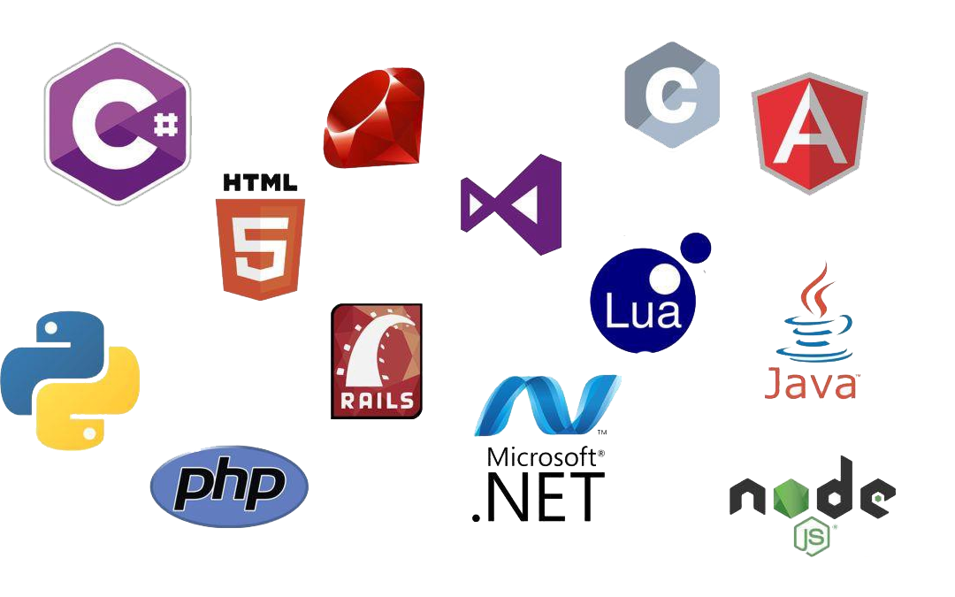
So many languages
Notes:
Each programming language has advantages but also disadvantages that should be considered. Often the selection of a language also determines the subsequent evolution of the developer. Even more, when it comes to using language for educational purposes, there are individual elements that need to be considered.

Slide 4

B4X Language
Easy to learn for kids and new programmers.
Provide an integrated development environment without confusing.
Students can develop applications on different platforms like Windows, Android, IOS, Linux, Raspberry Pi, Arduino etc.
Provide all modern data structures as lists, maps etc.
It has a very enthusiastic audience that gladly help in any kind of question.
Notes:
The B4X programming language provides all the above features and is also a language for developing high-level applications which can be a springboard for future professional development.

Slide 5
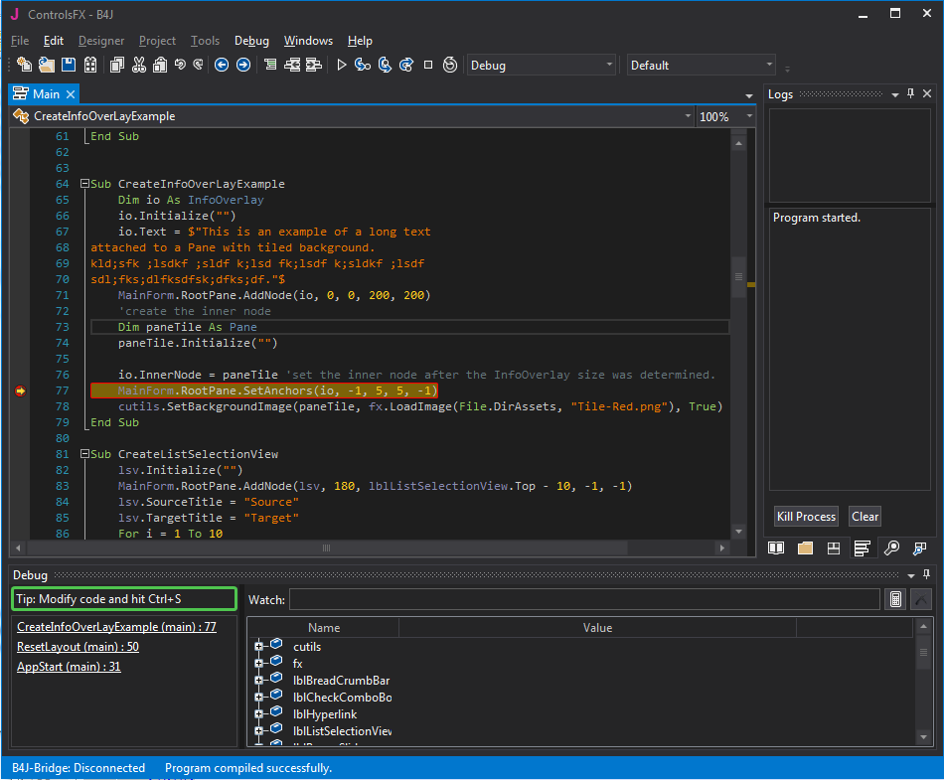
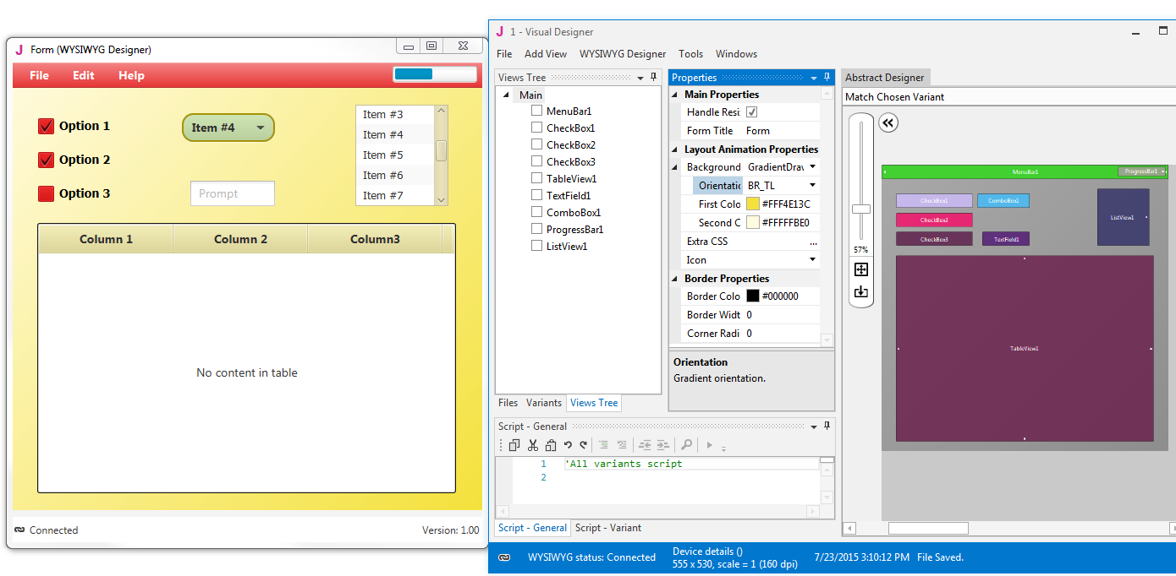
B4J - RAD development tool
B4J is a 100% free development tool for desktop, server and IoT solutions.
With B4J you can easily create desktop applications (UI), console programs (non-UI) and server solutions.
The compiled apps can run on Windows, Mac, Linux and ARM boards (such as Raspberry Pi).
https://www.b4x.com/b4j.html

Slide 6
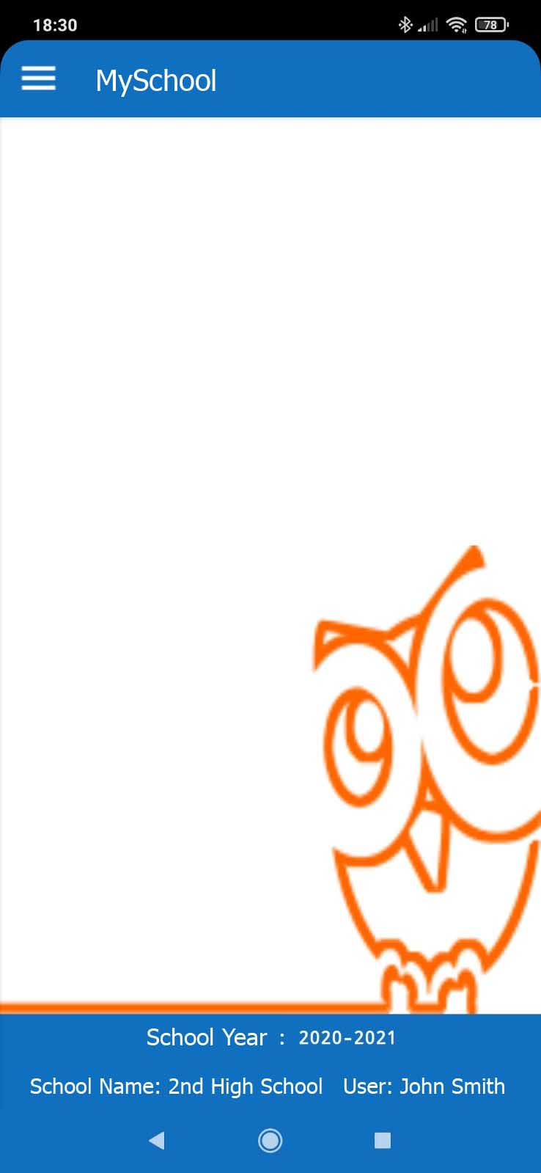
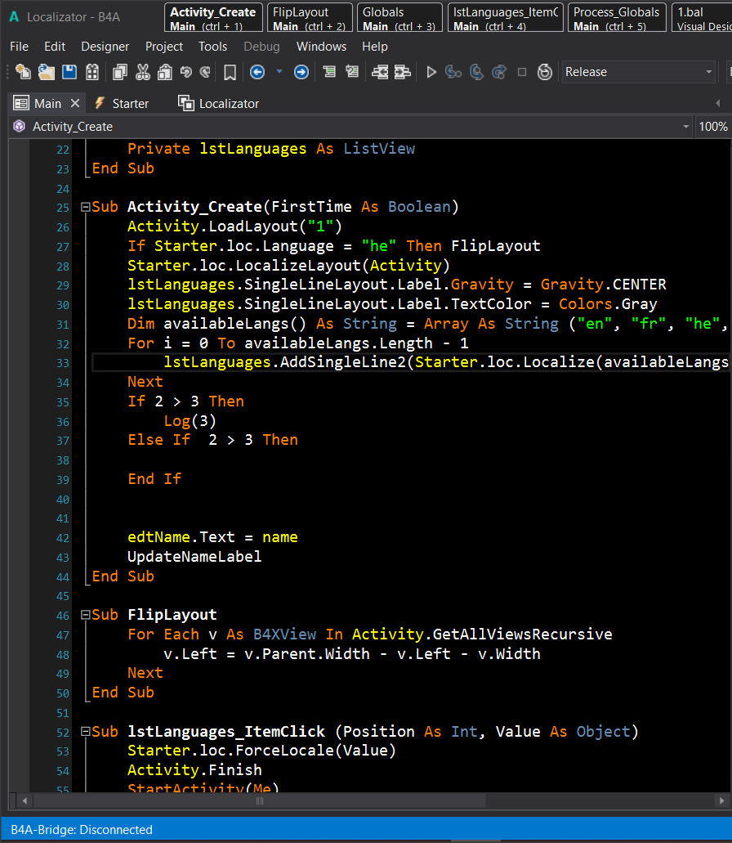
Β4Α - Develop native Android apps
B4A includes all the features needed to quickly develop any type of Android app.
B4A is used by tens of thousands of developers from all over the world, including companies such as NASA, HP, IBM and others.
Together with B4i you can easily develop applications for both Android and iOS.
B4A is 100% free.
https://www.b4x.com/b4a.html

Slide 7
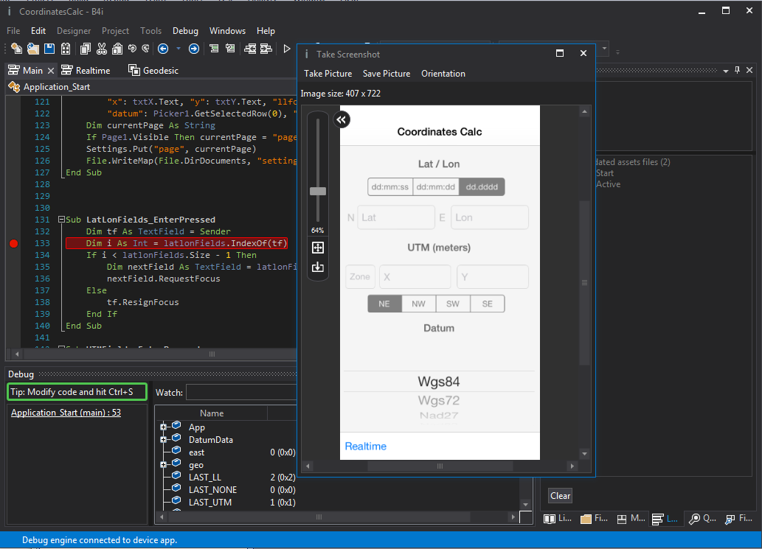
B4I – Develop Native iOS apps
B4i is a development tool for native iOS applications.
B4i follows the same concepts as B4A, allowing you to reuse most of the code and build apps for both Android and iOS.
This is the only development tool that allows you to develop 100% native iOS apps without a local Mac computer.
https://www.b4x.com/b4i.html

Slide 8
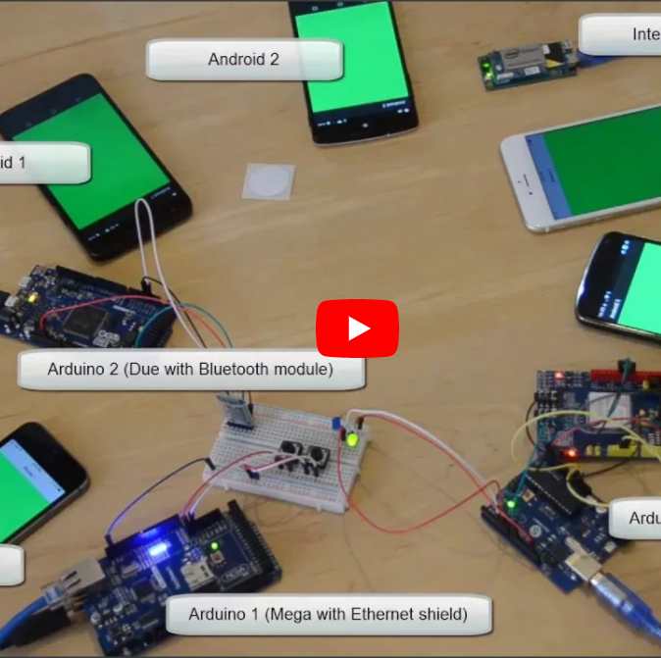
B4R–Arduino & ESP8266 programs
B4R is a 100% free development tool for native Arduino, ESP8266 and ESP32 programs.
B4R follows the same concepts of the other B4X tools, providing a simple and powerful development tool.
B4R, B4A, B4J and B4i together make the best development solution for the Internet of Things (IoT).
https://www.b4x.com/b4a.html

Slide 9
How to download and learn more
https://www.b4x.com
https://www.b4x.com/learn.html

Slide 10
Thank you!!!

